Slide 1
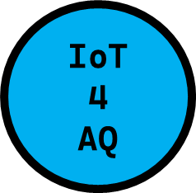


AIR QUALITY AND IoT-BASED AIR SENSORS – PART 2: PROGRAMMING MICROPROCESSORS
DEMO N° 3
ESP32/Wi-Fi module/PMS5003
Uli Raich

Slide 2
Here is the agenda…
Machine Language
High Level Languages
Arduino SDK
MicroPython
Microcontrollers running Linux

Slide 3
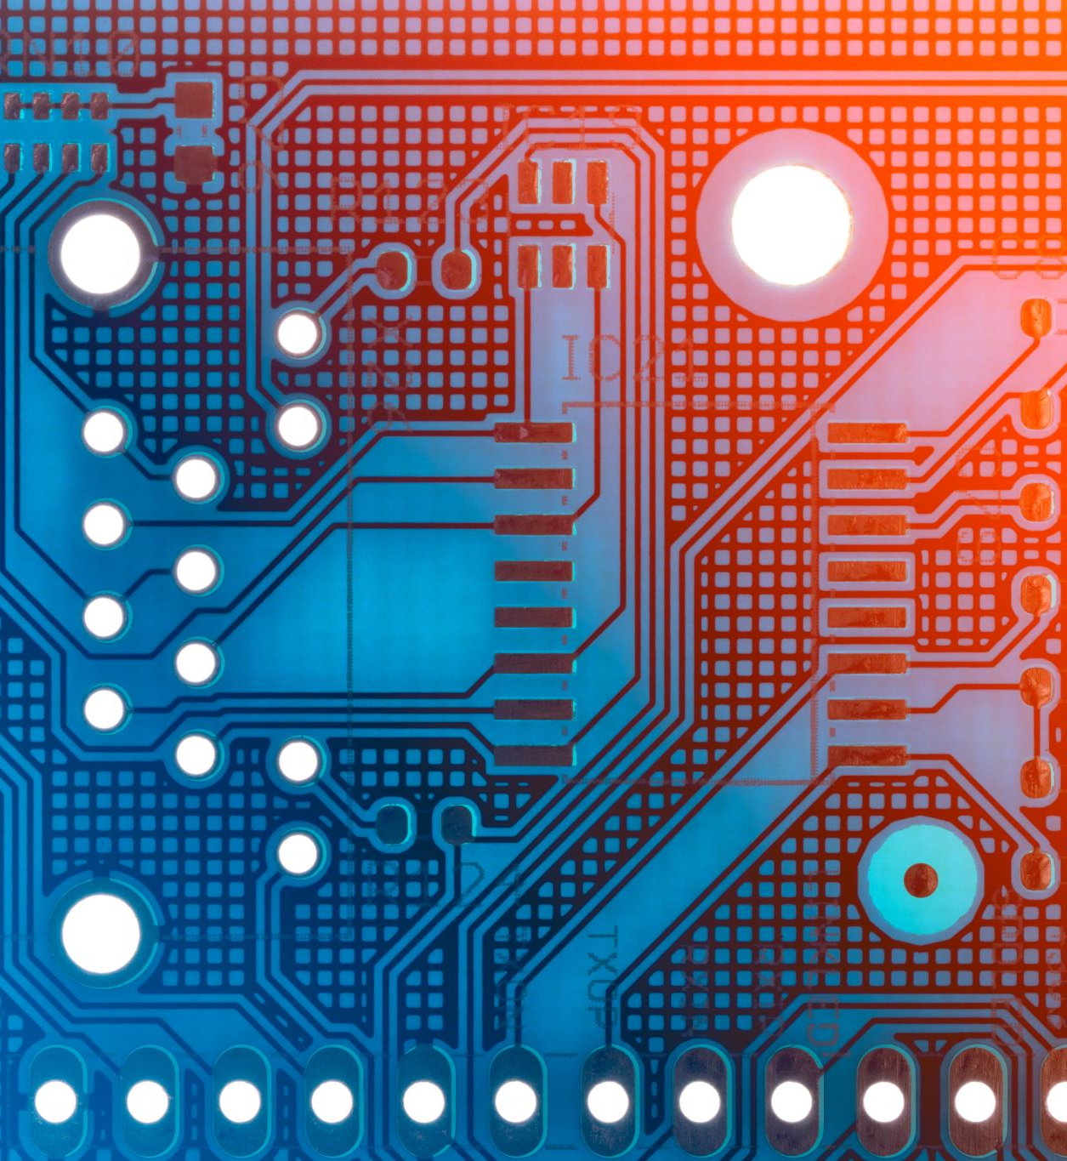
1. Machine Language

Slide 4
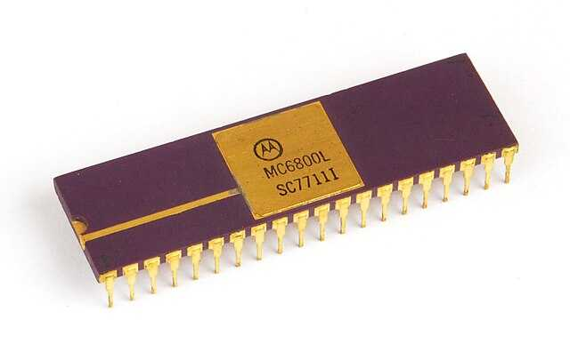
Assembly Language
These micro-processors were very limited due to their very small memory footprint.
Micro-processors only understand binary coded instructions and every micro-processor type has its own instruction set. In case of the early microprocessors the memory (and the instruction code) was 8-bits wide. We talk of 8-bit micro-processors.
In case of the M6800 development kit, programs were written in assembly language.
This is a (somewhat) human readable programming language with a one to one correspondence with the binary instruction code. In the first course I gave, we wrote the programs on a piece of paper and translated it into machine code by hand. The machine code was then entered using the keyboard.
There were programs (cross-assemblers) which ran on a big computer and which could do his task automatically.
The first samples of the M6800 micro-processor costed several hundred US$

Slide 5
2. High level languages

Slide 6
High level languages
Assembly language reflects all the details of the micro-processor hardware because you talk directly to registers and memory, which is difficult, and a program written for processor A does not run on processor B
High level languages like Fortran, C, C++, Java, Python … overcome these problems. Programmers writing code in these languages do not need to know the details of the micro-processor hardware. There is a compiler translating the high level code to assembly language for the machine in question and an assembler, which converts the assembly code into machine instructions.
If the compiler runs on the target machine we speak of a native compiler, if it runs on a different machine and is later uploaded to the target, we speak of a cross-compiler.
Today, almost all programs are written in a high level language. The most popular ones for micro-controllers are C or C++. For more powerful processors Python is a popular choice.

Slide 7
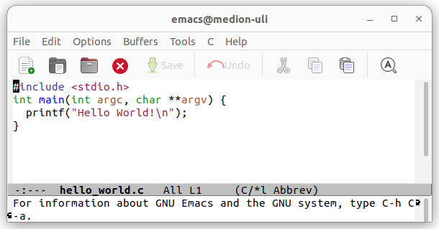
hello_world.c
Let us follow what happens when we compile the ubiquitous hello_world.c program:
Normally we compile, assemble and link, in an automatically executed sequence and do not look at the intermediate steps

Slide 8
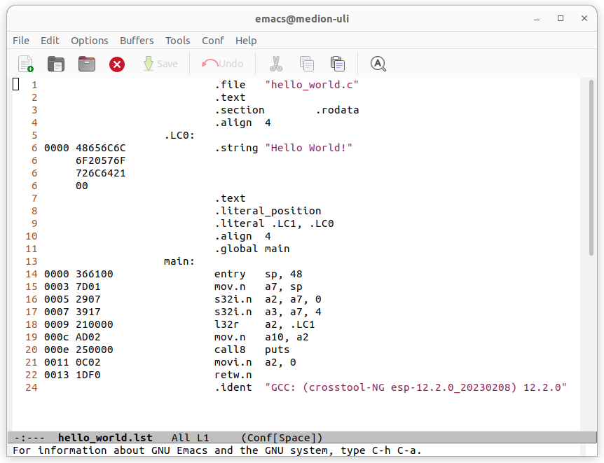
Translate to assembly code
First the program is translated to assembly code
This has a one to one correspondence with machine instructions
The assembly code is translated into binary machine code
The machine code is linked to libraries to produce the final executable

Slide 9
Compiler versus Interpreter
While compilers translate the source code into a binary program, which is uploaded to the target hardware, an interpreter translates the code on the fly.
In this case the source code is usually translated into byte code, which is binary code for a virtual machine. The virtual machine, a program that acts like a processor with its own instruction set, converts the byte code into the instruction set of the underlying hardware.
The interpreter must run on the target machine. Since this is a rather big program this method can only be used on targets with more resources.
The programs run slower, but you can execute instructions with writing a full program, which makes debugging substantially easier.

Slide 10
SDKs by hardware manufacturer
Most micro-controller manufacturers provide a Software Development Kit (SDK) for their chips.
These contain
A cross compiler and linker
A build system which automates the compile and link process. Typical build systems are make, cmake, ant, bazel ...
A program to upload the binary code to the micro-controller
Some SDKs have a GUI (Graphical User Interface) into which an editor, the compiler and a debugger are integrated. These are usually called IDEs (Integrated Development Environment)

Slide 11
SDKs for the ESP32
Depending on the processor used, several programming environments are available. For the ESP32 you have:
esp-idf (ESP integrated development framework) provided by Espressif (not recommended for a beginner programmer)
The Arduino SDK (Software Development Kit) originally developed for the Atmel Atmega chips but today available for many micro-controllers including the ESP32.
MicroPython. A stripped down Python-3 interpreter with additional features needed by micro-controllers available for several chips including the ESP32.
In these lectures we use the Arduino SDK
The board module for the ESP32 in the Arduino SDK is based on the compiler and libraries of esp-idf

Slide 12
3. The Arduino SDK

Slide 13
Configuring the Arduino SDK
Before we start programming:
The target machine must be selected
The micro-controller must be connected to the development machine on which the SDK is running, through a serial line. Most target machines use an USB to serial converter
The serial port for uploads must be chosen
The baud rate for upload of binary programs the micro-controller must be selected
Then we can start editing our program

Slide 14
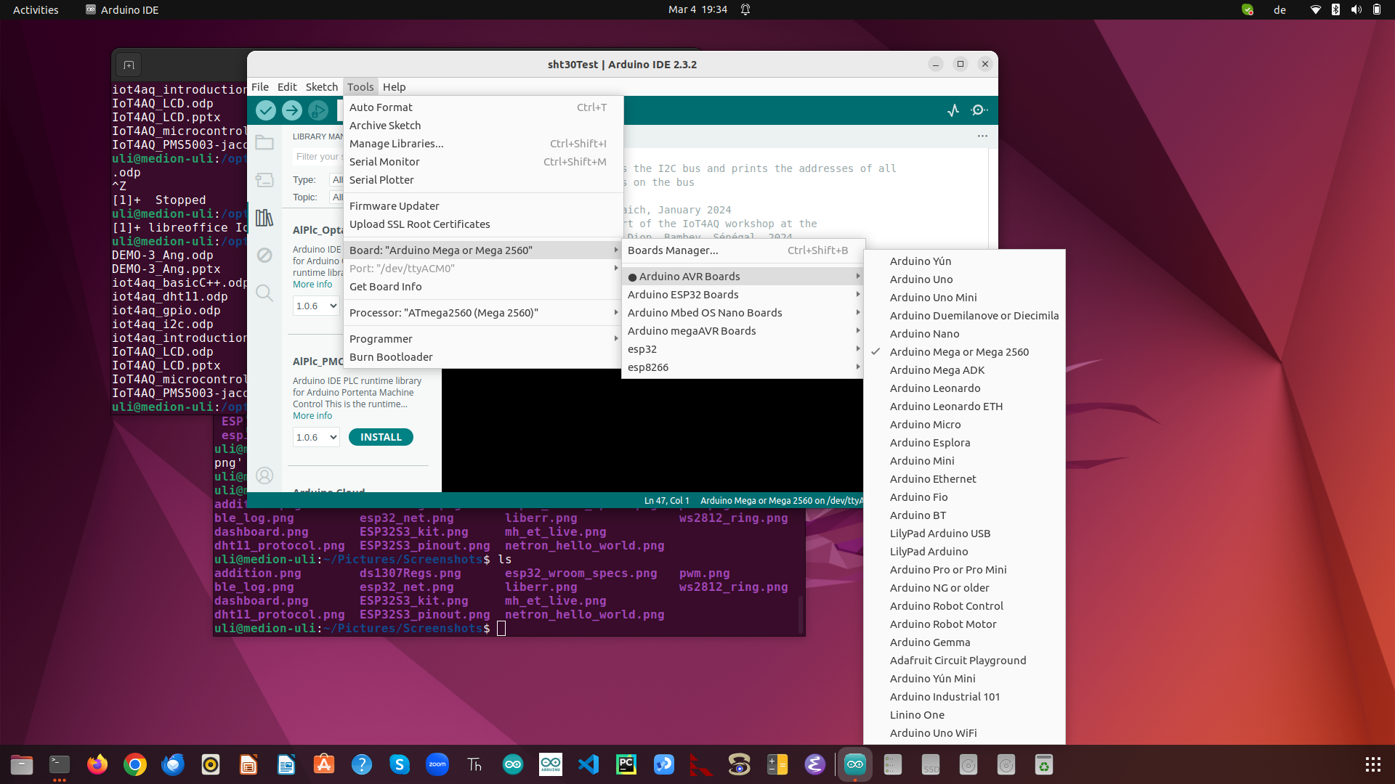
1. Microprocessors

Slide 15
Arduino program structure
The Arduino programming language is a C++ like language. Most C++ constructs are available
Due to the limited resources of the micro-controller some of the libraries are restricted. Printing is a typical example
An Arduino program consist of 2 parts:
A setup function which is executed once. This function performs all initialization needed, including initialization of sensor and actuator devices
A loop function which is run repetitively.
A micro-controller program almost always has an endless loop

Slide 16
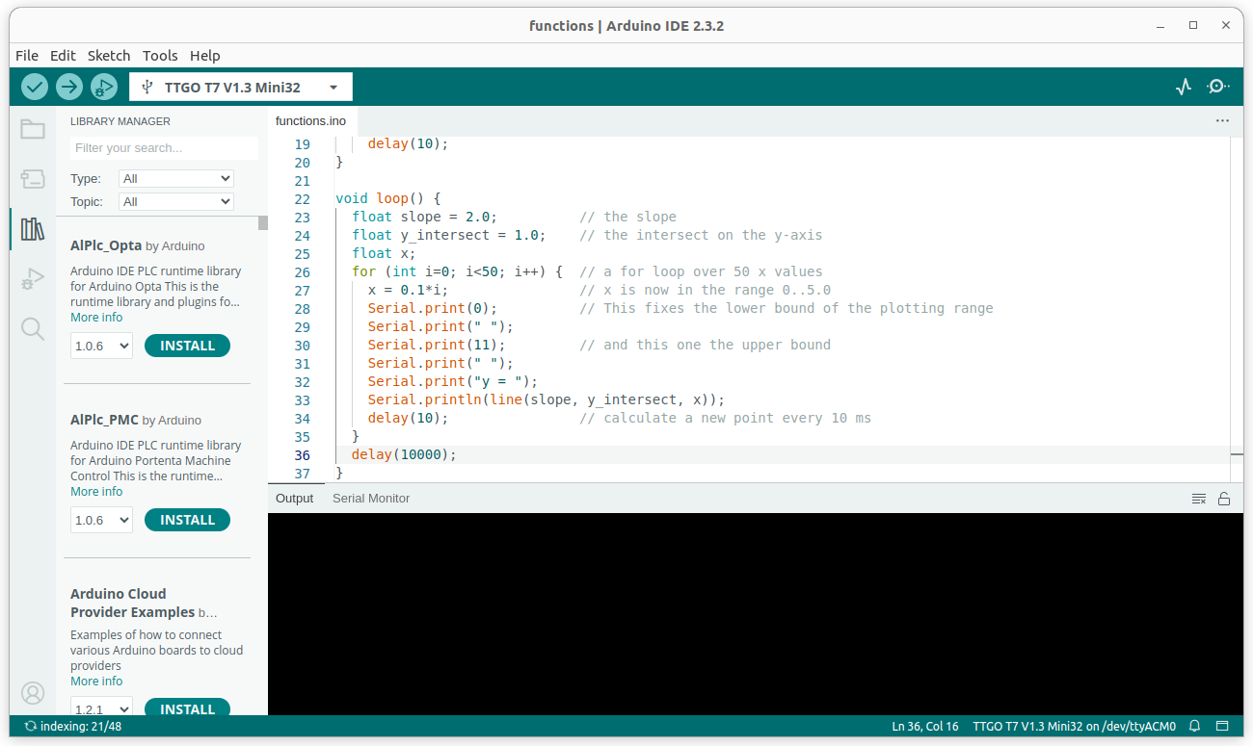
Arduino SDK screen dump
There are buttons to
Compile
Compile and upload
Start the serial monitor
Start the data plotter
And the is an area for
Compiler messages
The serial monitor
And a separate plotter window

Slide 17
Testing the system
In C the ubiquitous “hello world” program checks if
You can edit a program
You can compile and link it
You can run it
On embedded systems the simplest program possible is often the “blinking led” program
It shows that you can access the system and that interfacing works

Slide 18
5. Linux based machines

Slide 19
MicroPython
The Arduino AVR processors are not powerful enough to run a Python interpreter.
The Raspberry Pi runs a full Linux operating system and has access to all its applications including CPython, the standard Python interpreter and its libraries
The ESP32 is somewhere in between. It can run a stripped down Python interpreter called MicroPython, which has extensions needed to access external devices connected through one of the hardware interfaces, GPIO, I2C, SPI UART.
As explained in a previous slide, in Python the source code is converted to binary code on the fly and no compilation step is needed before execution.

Slide 20
Tools for MicroPython
Before being able to use MicroPython the interpreter must be installed on the ESP32 flash. This is accomplished with esptool.
Then, all that is really needed, is a serial connection to talk to the interpreter on the ESP32 and a program to upload code.
minicom is such a terminal emulator and ampy allows to upload (source) code and execute it.
Finally there is thonny, a simple IDE, which allows you to edit programs, upload them and run them. (See later)

Slide 21
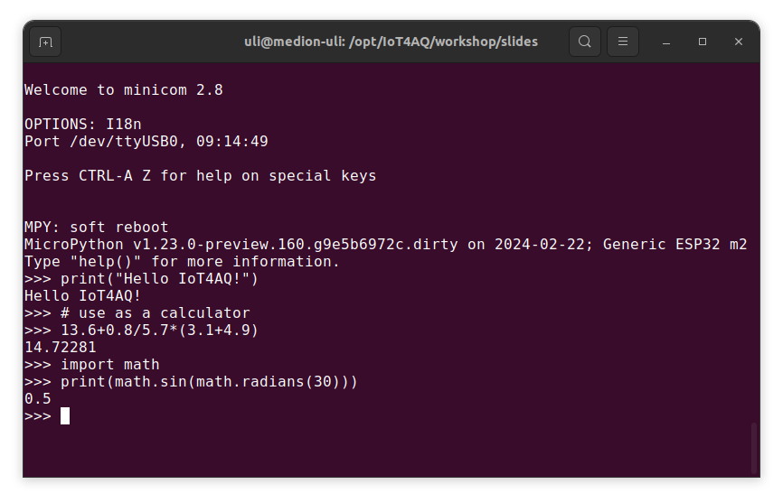
minicom

Slide 22
Thonny, simple IDE for MicroPython
Just like the Arduino SDK with its editor, C++ compiler, up-loader and serial monitor, MicroPython has an IDE called “thonny”
It allows to edit programs, upload them to the ESP32, execute them and see the results on a terminal window.
The terminal window also allows to access MicroPython’s REPL (Read, Execute and Print Loop). Like this commands can be given to MicroPython without a program.
In fact it is possible to control external devices without writing a single line of code.
MicroPython implements a simple file system in flash, onto which code, libraries but also images, sound files … can be stored.

Slide 23
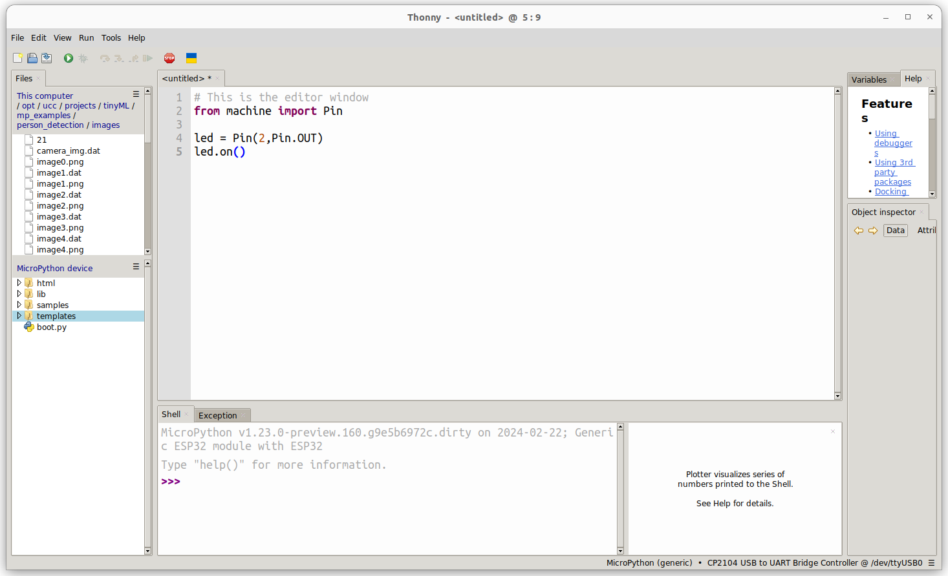
Thonny

Slide 24
A WEB server controlling the user LED

Slide 25
5. MicroPython

Slide 26
Software development on the RPi
The specifications on a previous slide show that the Raspberry Pi is vastly more powerful than all the other micro-controller we have seen before.
In fact, the Raspberry Pi should be considered a complete small computer.
It can use a big SD card as its “hard disk” and run a full-blown Linux operating system.
It has an HDMI interface onto which you can connect a monitor screen and it has 4 USB interfaces that can be used with a keyboard and a mouse.
This allows to run Linux autonomously and to have a desktop on the connected screen. All Linux programs can be executed and the C, C++ … compilers can be run natively.
The full C-Python interpreter is available and of course all the Linux network capabilities are there.
However, the Raspberry Pi is also a factor 20 more expensive than an ESP32 not counting the price for screen, keyboard and mouse.

Slide 27
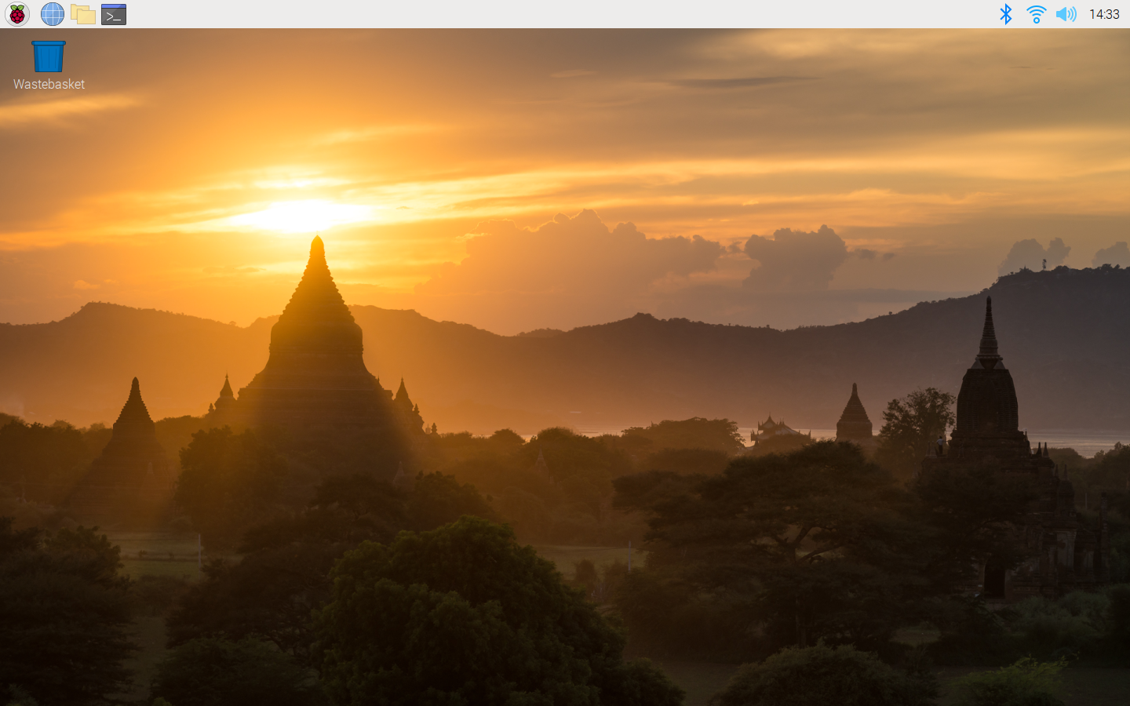
Raspberry OS desktop
The Raspberry Pi allows to connect external devices through
GPIO
UART
SPI, I2C or CAN bus
just like the ESP32 or the AVR Arduino boards. It does not have a built-in ADC though.

Slide 28
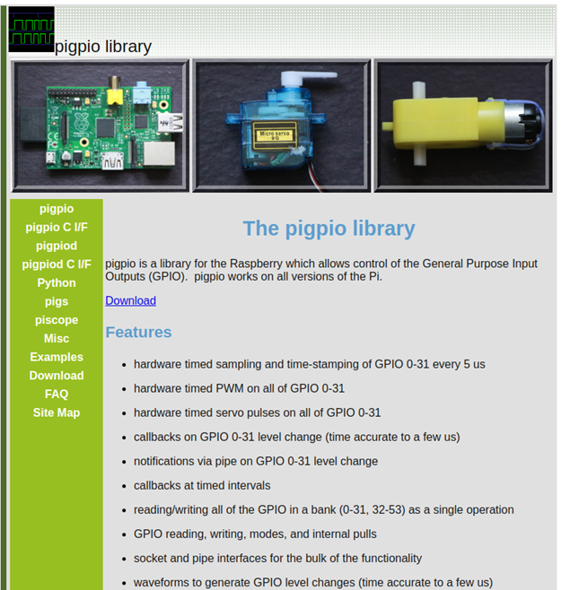
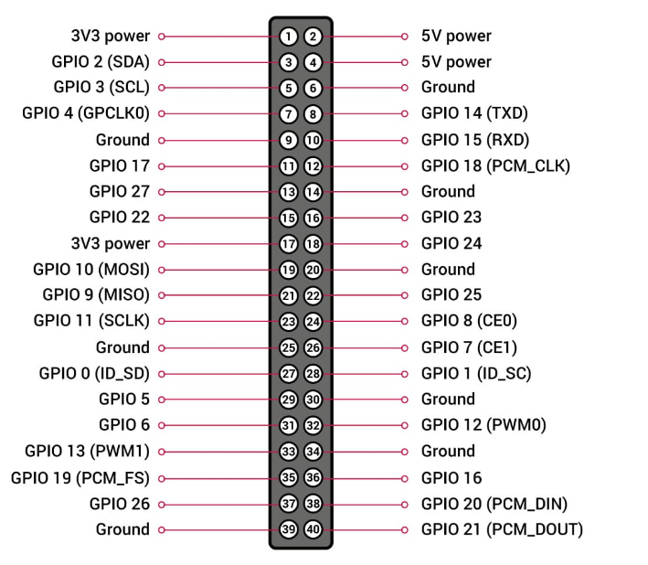
Raspberry Pi pin out
Raspberry Pi

Slide 29
References
The C++ Programming Language, Bjarne Soustrup
Arduino Cookbook. O’Reilly
Developing IoT Projects with ESP32, Bedat Ozan Oner
The MicroPyton documentation: https://docs.micropython.org/en/latest/
Raspberry Pi: https://www.raspberrypi.com/
https://afnog.iotworkshop.africa/do/view/Main/WebHome (embedded systems with Raspberry Pi (C- language), IoT with ESP32 using MicroPython

Slide 30
If you find any difficulty, at any step, please feel free to contact us! Dr. J. Taamté (mtjfirst@yahoo.fr) Dr. Uli Raich (uli.raich@gmail.com) Dr. B. Tchanche (bertrand.tchanche@uadb.edu.sn)

